Slide 1
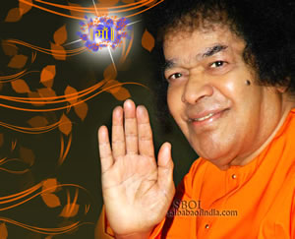

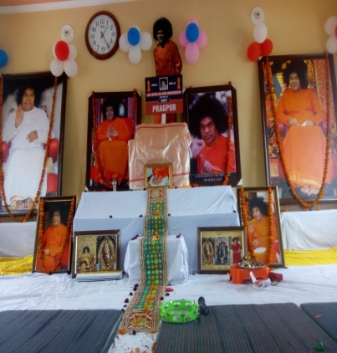
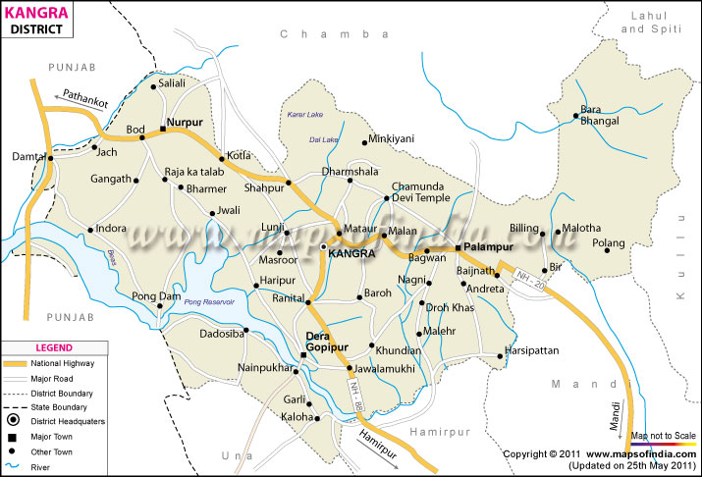
Sri Sathya Sai Seva Organization Distt. Kangra (HP)
Annual Activities 2019
Help
Ever,
Hurt
Never.
Love All, Serve All.

Slide 2
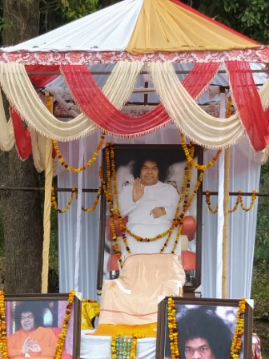
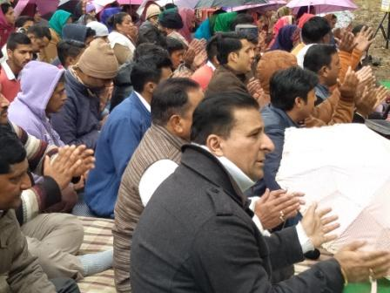
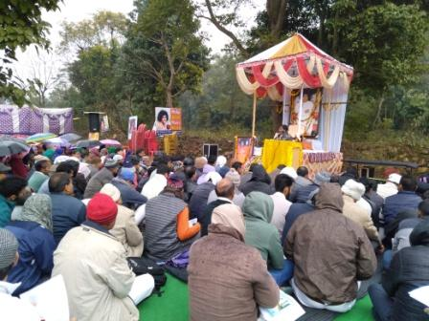
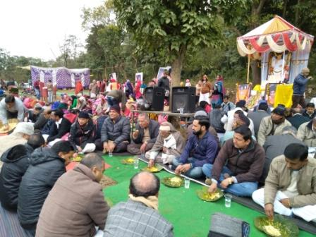
Preparation of Annual Calendar
06-01-2019 Preparation of Annual Calendar by active members

Slide 3
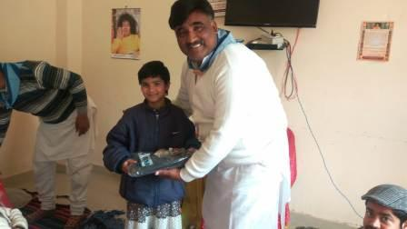
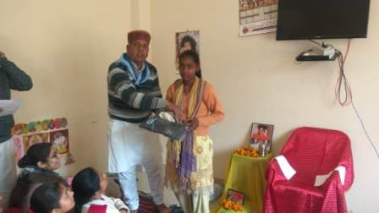
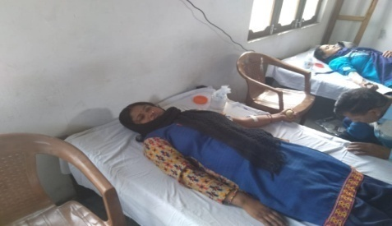
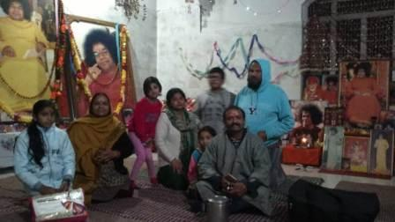
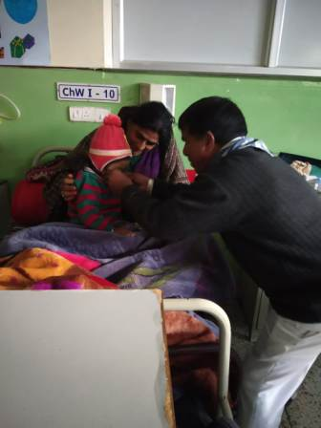
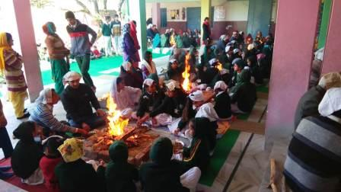
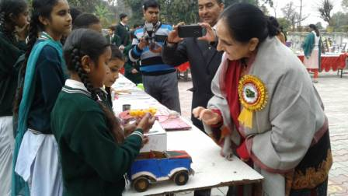
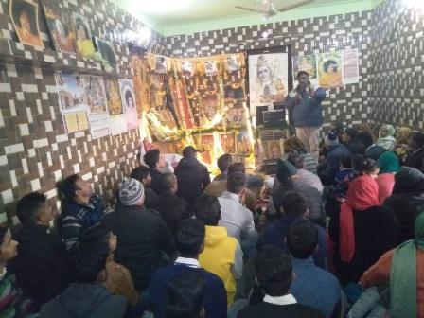
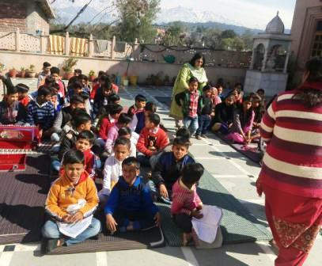
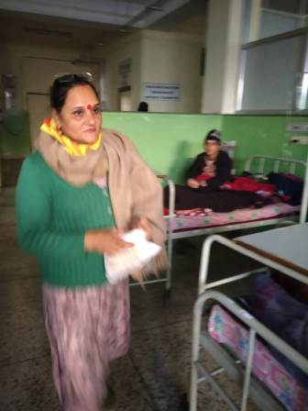
January 2019
Activity with date
06-01-2019 Preparation of Annual Calendar by active members
11-01-2019 First rehersal of Boys, preparing the chidren for Puttaparthi Program.
12-01-2019 First blood Donation camp at Neharn Pukhar (Dehra) 45 units donated
13-01-2019 Lohari festival celebrations at Balika Ashram Garli (Dehra), Anatha Asharm Patti saliana (Palampur). Distribution of woollen clothes and sweets. 85 children are the beneficiaries. Jail Visit Nurpur and Dharmshala.
14-01-2019 Special Nagar Sankiratan and Bhajan on Makarsankranati
17-01-2019 Narayan Seva at Tanda Hospital.
19-01-2019 Youth Conference at Bankhandi (Dehra) 42 Youths participated.
20-01-2019 Vidya Vahini Program at Jasuur, Vidya Jyoti Meeting at Jawalamukhi, Preparation of Samiti Level Activity calendar. 23-01-2019 Distribution of 45 Woollen Trousers to Girls at Orphan Home Garli by Lanj Samiti. 27-01-2019 Second Rehearsal of Boys for Puttaparthi Program. 31-01-2019 Old age Home visit Dharmshala

Slide 4
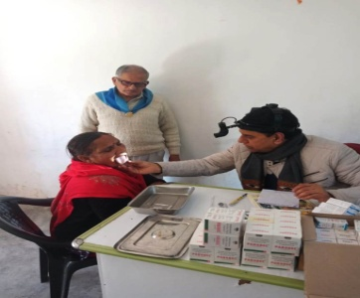
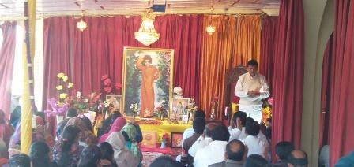
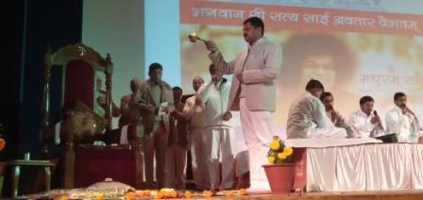
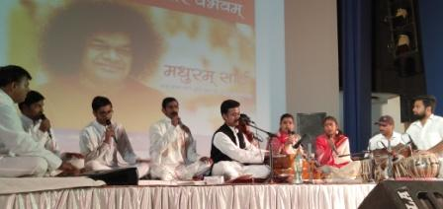
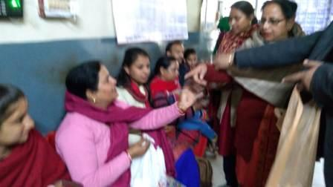
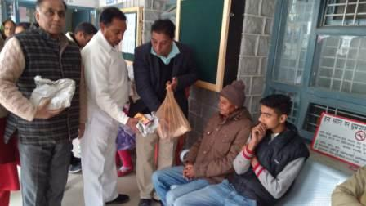
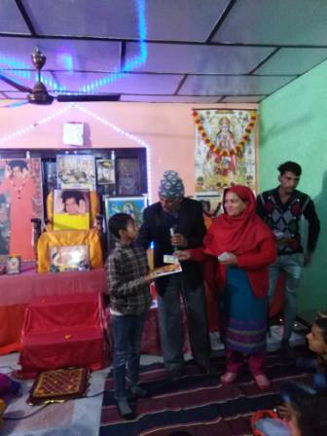
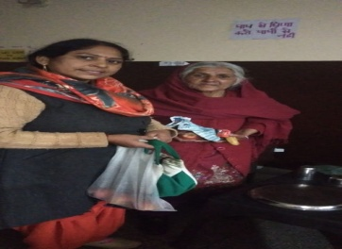
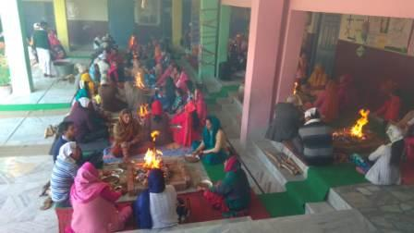
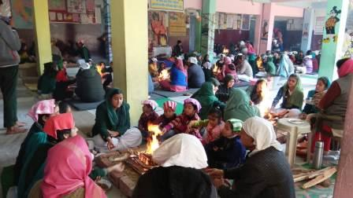
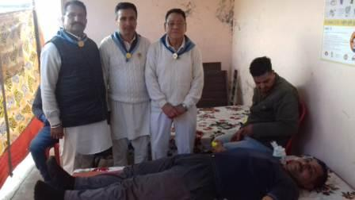
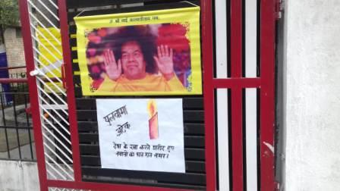
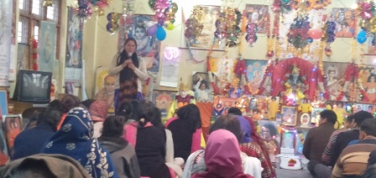
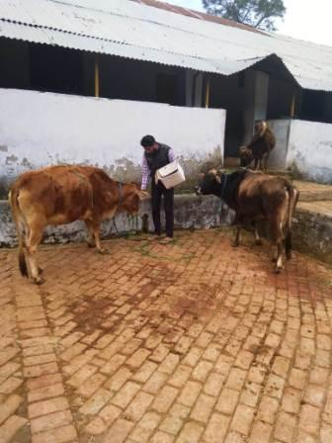
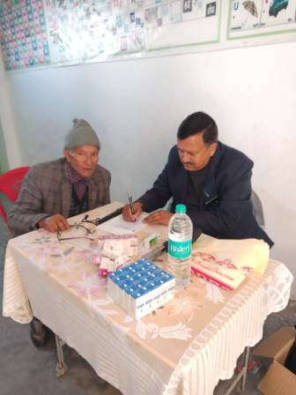
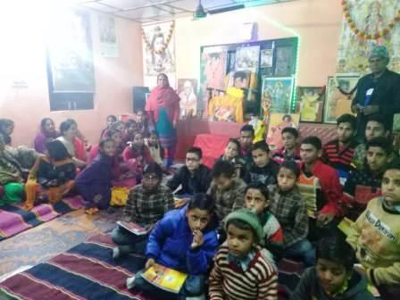
February 2019
Activity with date
2,3,4 -02-19 Visit of State President and coordinators Palampur , Kotla , Dharnshala , Dehra
03-02-19 Medical camp at Panckrukhi total OPD 254 distributed Free medicine
03-02-19 Bhagwan Sri Sathya Sai Avatar Vaibhavam by Dr. Hem Raj at Dharmshala
05-02-19 visiting Orphanage home at Patti Saliana (Palampur)
06-02-19 Hospital visit at Bhawarana distribute Bibhuti and Fruits
09-02-19 Distt jail Visit at Dharmshala distributed Bibhuti and Fruits. Havan Program at Adarsh Bharti Public school Jasuur
15-02-19 Visit at Old age home and Nurpur jail visit
17-02-19 Blood Donation camp at Kandrori (Indora) total 40 unit Blood Donated to Dr. RPGDC Tanda
21-02-19– Dhaam Material Delivering Ration in the Marriage of Poor Family (Daughter’s) Three places Sakri, Garli, Dehra 24-02-19 Sunder kand Path recitation at Jawali And Gokulam visit by Bankhandi Samiti

Slide 5
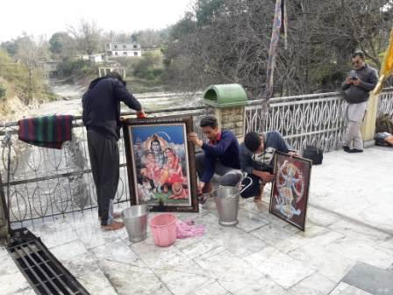
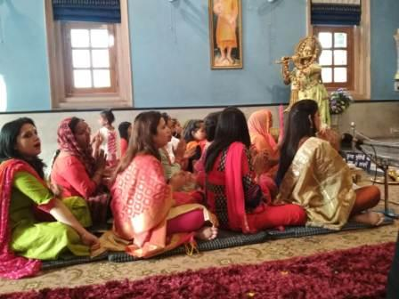
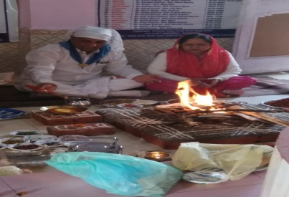
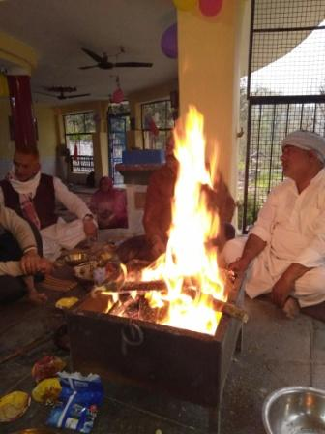
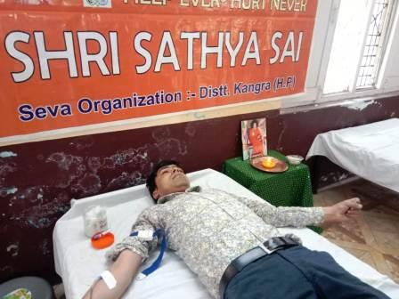
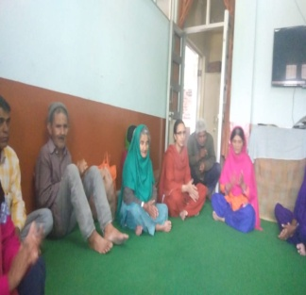
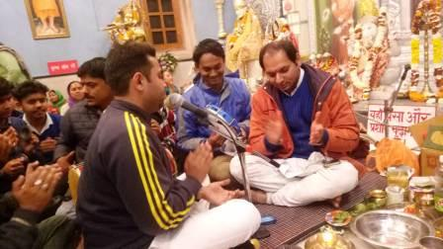
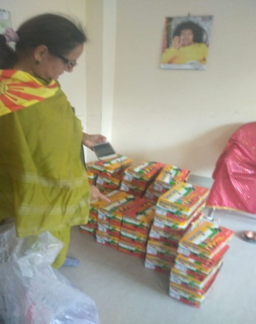
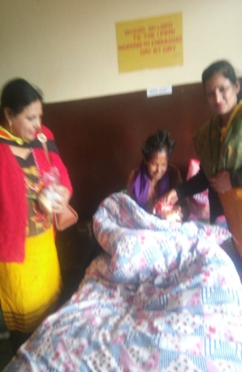
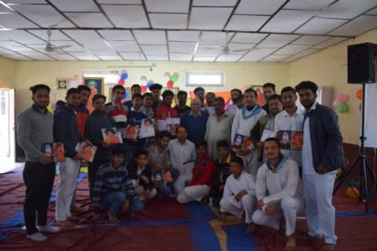
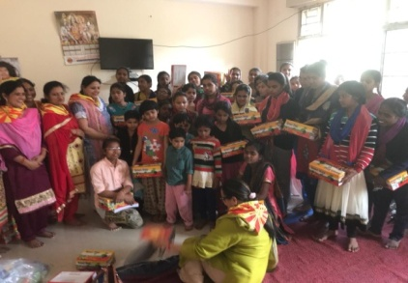
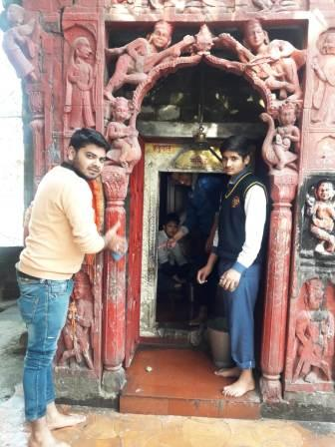
March 2019
Activity with date
01-03-19 Youth Activity at Zonal Level (Lanj and Kaleshwar Mahadev) 43 youth participanting in Cleaning the Temples
04-03-19 Shivratri Programs Shiv Parivar Poojan , Bhajan, ShobhaYatra, Narayan Seva at Samities level
17-03-19 Blood donation Camp held at Kotla total 74 blood unit donated
24-03-19 Ram Navmi Program 21 kundliya Havan at Bhawarna (Havan – Maa Durga)
25-03-19 Visit Old age Home Distributed Sweats and Fruits by Lanj Samiti
27-03-19 Visit Balika Ashram Garli Distributed 44 pairs of Shoes for Girls

Slide 6
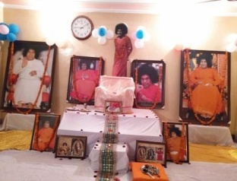
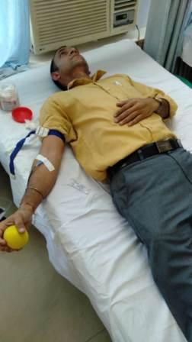
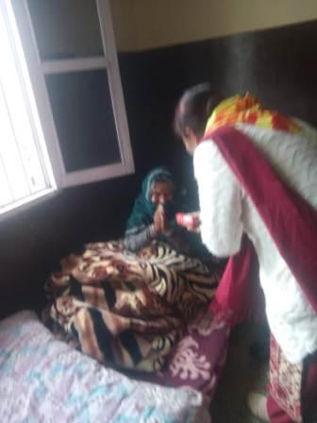
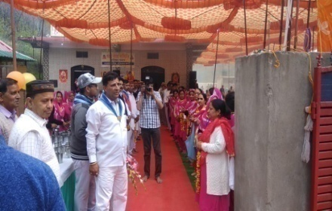
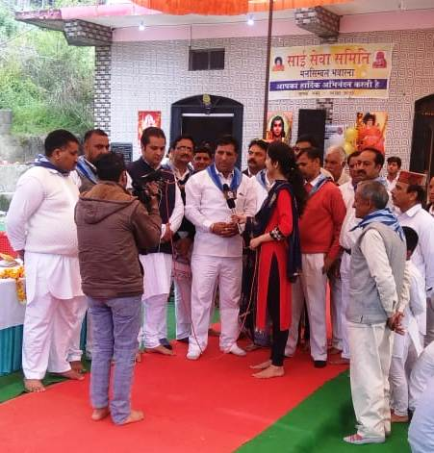






April 2019
Activity with date
07-04-19 Bal Vikas Bhajan and Dance Practice at Dharmshala
09-04-19 Visit old age home and distributed clothes for ladies and gents with Sai Bhajan
10-04-19 All India Spiritual coordinator visited at Distt Kangra (Pragpur) Addressing 120 Ladies and gents about Spirituality
14-04-19 Visit Zonal Hospital and Distributed Fruits for Indoor Patients by Plampur Zone
21-04-19 Sai Gokulam Annual Program with Bhajan, Havan and Gauseva
24-04-19 Aradhana Divas at Samiti level and Blood Donation Camp at Lanj 75 units Blood Donated to Dr. RPGDC Tanda (Kangra)

Slide 7




May 2019
A special Visit of All Inida President Sh. Nimish Panday ji
Activity with date and detail
06-05-19 Eshawaramma Day Celebration of Bal vikas Programme
06-05-19 Distributed ladies suites for needy ladies
12-05-19 to 14-05-19 Arrangement AIP SSSSS Organization (India)
15-05-19 AIP Sh. Nimish Panday warm Welcomed at Gagal Airport by 100 Active Seva dal of Distt kangra and State with the Guidelines of State President Dr. Sanjay Agarwal and Distt PresidentSh. Shesh Bhushan ji
15-05-19 AIP Sh. Nimish Panday addressing the 8000 (Eight Thousands) Peoples about God and warm welcome by all Bal vikas Boys and Girls with the Name and Photo Sai, Durga Ma, three program of Bal-Vikas (Dance, Beti Bachao and Pahadi Nati)
16-05-19 AIP Sh. Nimish Panday visit at Vidya Jyoti GSSS Bankhandi addresseing the students Dr. Bharti addressing the Girls on health hygiene. Dr. Alok Sharma addressing the boys for importance of Yoga in daily life.
16-05-19 AIP Sh. Nimish Panday visited at Chanour Blood Donation Camp. 58 units blood donated to Dr. RPGDC Tanda (kangra) and then visit at Sai Gokulam place banuri.
16-05-19 AIP Sh. Nimish Panday visited at Sai Gokulam place banuri attend GAU MATA pujan and plantation
16-05-19 AIP Sh. Nimish Panday visited at MA JAWALA MATA Temple attend SAI SANDHYA Arrange by Youth.
17-05-19 AIP Sh. Nimish Panday visited at Dharmshala (Mechlodganj) meet with Guru Dalai Lama ji
17-05-19 AIP Sh. Nimish Panday visited at Palampur inauguration new SAI Temple and addressed the Sai devotees. And meeting with Veterinary Doctors
17-05-19 AIP Sh. Nimish Panday visited Dharmshala at Govt. College Auditorium and Addressed the college students and Lectures, B.Ed Trainee and Professor , and Some Pvt Colleges Students and Teacher, Central University Himachal Staff.

Slide 8

















Slide 9












June 2019
Activity with date
02-06-19 All Samities conveniors meeting for Prashanti Sevadal at Nagrota Bagwan
07-06-19 Visited at distt Handicap home distributed Cloths , sweats and Fruits by Palampur Zone
13-06-19 Vidya Jyoti School Program at GHS khera School Headmaster Sh. Vijay Awasthi ji distributed Track suit for 48 Students
17-06-19 Veterinary camp at Nahlia total 47 Animals checked by Doctors and distributed free medicine and calcium packed.
21-06-19 Yoga Day Celebration At Samiti level. Vidya Jyoti School.
23-06-19 Youth Activity at Sai Goukulam at Banuri Dehra Zone Youth some Plantation and cover Area of Sai Gokulam.
30-06-19 youth conference by Palampur Zone at SSSSS Bhatoo Addressed by Sh. Shesh Bhushan and Sh. Roshan Raina

Slide 10








July 2019
Activity with date
04-07-19 Tree Plantation at Samiti level at and Sai Gokulam Banuri
07-07-19 Pre Seva dal Meeting , Bhajan and Havan at Maa Chintpurni
One Bal-vikas Girl 3rd in essay writing competition of all India SSSSS. Prize given at Kulwant Hall
23-07-19 to 31-07-19 Prashanti Nilayam seva, 352 Female and 302 Male assemble there.
27,28-07-19 Parthi Yatra

Slide 11










August 2019
Activity with date
11-08-19 Blood Donation camp at jassur, 34 Blood Units donated to Dr. RPGDC Tanda .
15-08-19 A special Bhajan at Old age home and distributed fruits and sai Bibhuti Prashadam
18-08-19 Blood Donation Camp at Khera, 57Blood units donated to Dr. RPGDC Tanda
18-08-19 started one Water project Sai Jal dhara se Prem dhara (Hand pump) with reversible Machine for Villagers
19-08-19 Tree plantation at Samiti level
23-08-19 Janmaastmi Program at samiti level Bhajan and Balvikas program with Little- Little Krishna

Slide 12




















September 2019
Activity with date
01-09-19 Distt Kangra (Himachal) Seva dal Visited District Jalandhar (Punjab) for the help for needy all villagers. Clean the house and school. This area was under water due to heavy rain.
03-09-19 Visit Anathasram distributed 44 bathroom sleepers.
15-09-19 Blood Donation camp at Nagrota bagwna. 54 blood units donated to Dr. RPGDC Tanda.
15-09-19 Zonal Level Declamation at Dheera (Palampur) 26 students participated the declamation contest. First three participants selected to District Level competition.
22-09-19 Medical Camp at Kotla Behar total OPD 221 , distributed free medicines and checkup.
27,28-09-19 Shirdi baba Birthday celebration Samiti wise 24Hrs. Sequence Bhajan and Bal Vikas Program at Samiti Level.
29-09-19 Zonal level Declamation at Kangra (Dharmshala). First three participants selected to District Level competition.
29-09-19 Navratyre started with Jyoti Prajvalan and Bhajan, Sunder kand program. Marriage Dham material given to needy Family on Girl marriage.
29-09-19 youth conference at Sri sathya Sai seva Samiti Bankhandi 56 youth participated there.
30-09-19 9:00 Pm to 01-10-19 7:00 Am attend Bhajan (94Hrs) at Pujarli 43 devotees of distt kangra

Slide 13
October 2019
Activity with date
2nd October celebrated as a Swachta se Divyta at Govt. degree College Dhaliara with the students of college students on the guidelines of Retd. Principal BS Pathania, Sh. Shesh Bhushan, Sh. Neeraj Sharma and youth of Sai Organization
2nd October special Eye Check up Camp at Dehra Govt. Hospital by Dehra Zone 231 patients checked by Eye Doctor and 70 patients selected for free eye operation
Dated 4-10-19 youth Activity at Bankhandi Samiti level Swachta se Divyta in Ayurvedic Dispensary by the youth of Bankhandi samiti
Dated 06-10-19 Blood donation camp at Surani 54 units blood donated to Dr. RPGDC Tanda
Dated 06-10-19 Zonal level at Surani and Pragpur total 72 students participated form different schools
Dated 12,13 -10-19 Bal- Vikas Mela at Dehra in Distt. Level total 189 Boys and girls assembled there for different –different competition – Bhajan, Satutis , Vedam, Quiz, Games and Bhagwat shaloks
Dated 17-10-19 :- Slum area seva by Lanj samiti distributed Ladies Suhagi and Fruits with Narayan Seva for INT bhatta worker.
Dated 20-10-19 Avatar hood Day celebrated at Zonal Level – Palampur, Dehra, Lanj, Dharmshala, Nurpur
Dated 20-10-19 Declamation contest at zonal level Lanj, 22 participants participated the contest
Dated 24-10-19 :- Vidya jyoti program at schools – special on Deepawali at Bankhandi, Kotla behar, Khera, Lanj
Dated 25-10-19 Regular Sai Gokulam activities by 22 youth with Sh. Anurag Sood and Sh. Anil Verma
Dated 27-10-19 :- Deepawali celebration at Samiti and visit orphan house attended bhajan distributed sweets and sweaters

Slide 14


























Slide 15
Nobember 2019
Activity with date
DATED 03-11-19 Distt. Level Declamation contest at Pragpur. After the zonel level declamation contest selected candidate appear in district level declamation. Distributed prize for all participants and special prize trophies to 1st, 2nd and 3rd position candidates.
Dated 09,10-11-19 global Akhand Bhajan at 14 places of district Kangra- Garli, pragpur, Dehra, Bhatoli, Lanj, Jawali, Jassur, Kotla, Draman, Dharmshala, Nagrota Bagwan, Palampur-1,2
Dated 12-11-19 Blood Donation Camp at Bhatoli Phakorian, this month 63 units of blood donated to Dr. RPGDC Tanda
Dated 12-11-19 Free Eye operation camp at Dehra. This month, this work was done by putting by putting 78 eye free lenses and all this work was done with the cooperation of Dr. Chouhan ji , courtesy of Dehra Zone of Sri Sathya Sai Organisation Disrict kangra
Dated 17-11-19 start Swami’s 94th Birthday celebration at zone and samiti level with the wake up flame (Jyoti) at all Devotees home. And Sobhayatra at Dehra Zone Jawalamukhi mandir to Pragpur all Samiti of Dehra zone participated there.
Dated 18-11-19 visit old age home distributed sweats and fruits by Palampur Samiti.
Dated 19-11-19 Mahila Program at Lanj samiti and Bhajan at Adarsh Bharti Public School jassur
Dated 20-11-19 Visit Zonal Hospital and distributed fruits for patients and attendant.
Dated 21-11-19 youth activity at samti level with Naryan Seva
Dated 22-11-19 Shobhayatara at all zone with the samiti
Dated 23-11-2019 Birthday Celebration at Samiti level with Bhajan , Nagarsankirtan, Lakshya Archnaa, Bal Vikas Program, Cake ceremony .
Dated 24-11-19 A big program as a Birthday Program At Lanj about 5000 devotees assemble there. Program start with Bhajan then Bal vikas activities ,deliver the message for youth and Narayan Seva

Slide 16

























Slide 17










December 2019
Activity with date Dated 01-12-19 visit Anathashram distributed sweats and fruits for girls by Lanj and Garli samiti
Dated 04-12-19 visit Handicapped house distributed sweats and arrange one care taker person on base of salary and one teacher for boys by Lanj Samti
Dated 08-12-19 visit Gousadanv with Doctors team at Khajian Near Kotla. There are 292 cows. The Youth of Kotla samti gave jiggery and peddas to Cow along with the District President Dated 25-12-2019 Christmas day celebration by all Samities Dated 29-12-2019 Blood Donation camp at Bani, 55unit blood donated to DR. RPGDC Tanda

Slide 18





21-02-19– Dhaam Material Delivering Ration in the Marriage of Poor Family (Daughter’s) Three places Sakri, Garli, Dehra, Badukhar, Bhatoli Phakorian
24-02-19 Sunder kand Path recitation at Jawali And Gokulam visit by Bankhandi Samiti
Special Note: - All Centers are regular in Thursday Bhajan and other activities (Locally)
Two Boy Participant in Upnayan ceremony at Puttaparthi.
All Centers are regular in Thursday Bhajan and other activities (Locally)
2nd Saturday of every month Visit Distt Jail at Dharmshala
With love
Sri Sathya Sai Seva Organization
District President
Shesh Bhushan
9816162385

